Slide 1
Creating a New Database
The Sister Cities Database
Development Project

Slide 2
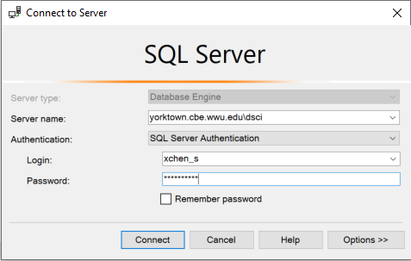
Logging into the DSCI Student DBMS
Before you can log in, your instructor will need to create your account.
Open Management Studio and connect to the database engine
Enter the DBMS (server name) as shown in the illustration
Select SQL Server Authentication
Enter your SQL Server login username and password
Click Connect

Slide 3
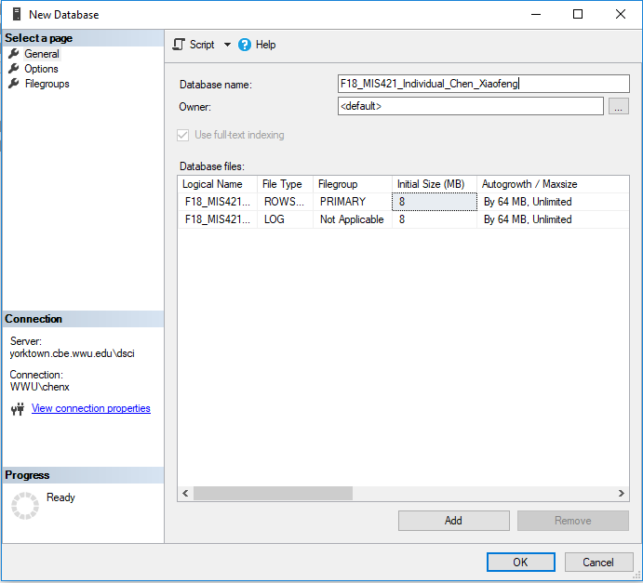
Creating a New Database
After Management Studio is connected with the database engine at yorktown.cbe.wwu.edu\dsci
Right-Click Databases in the Object Explorer pane, choose New Database…
Enter a Database name: the name always starts with the prefix of QYY_MIS421, where Q represents a quarter (F-Fall, S-Spring, W-Winter, SUM-Summer) and YY the last two digits of a year
Click OK

Slide 4
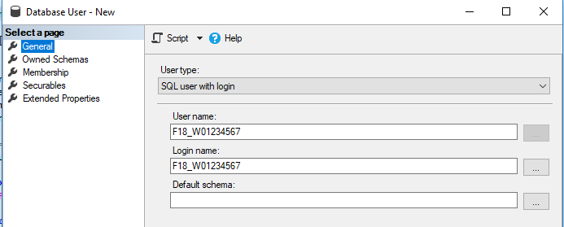
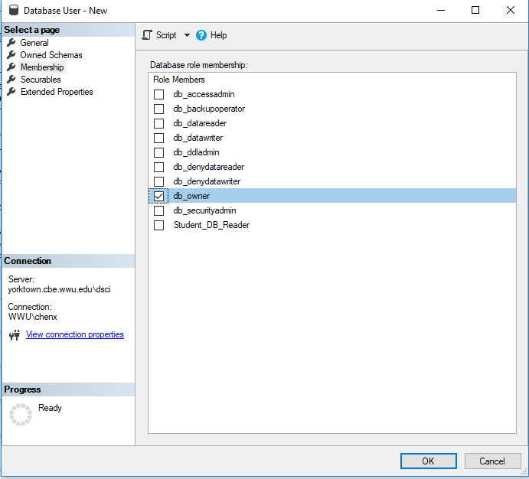
Assign your other login to the DBO Role
Note: Every student has two logins in the Yorktown SQL Server Management System(SSMS):
WWU Windows Account in the format of WWU\YourWindowsUsername. For example WWU\chenx
SQL Server login in the format of QYY_YourWNumber. For example W18_W01234567
This example supposes that you created the database with your WWU Windows Account
Expand Security in the new database; then right click Users and choose New User
Enter your QYY_YourWNumber for both the Username: and Login name: fields (see the top image at the right).
Select Membership on the left navigation pane, check db_owner
Click OK button at the bottom to finish the task

